Slide 1
WORKER’s MOTION study AT WORKPLACE

Slide 2
Objective:
The objective of this model is to :-
Watch the workers motions in the workplace area.
Determine the motions are required or unnecessary.
Show the repetitive tasks that is being perform by worker in defined optimum motion study or not.
Is worker following the preset working rules or not.
Benefits:
Detection of unproductive movements.
Gives better visibility of workshop area.
Helps in increase production rate in less time.
Better work rules to followed for safety .

Slide 3
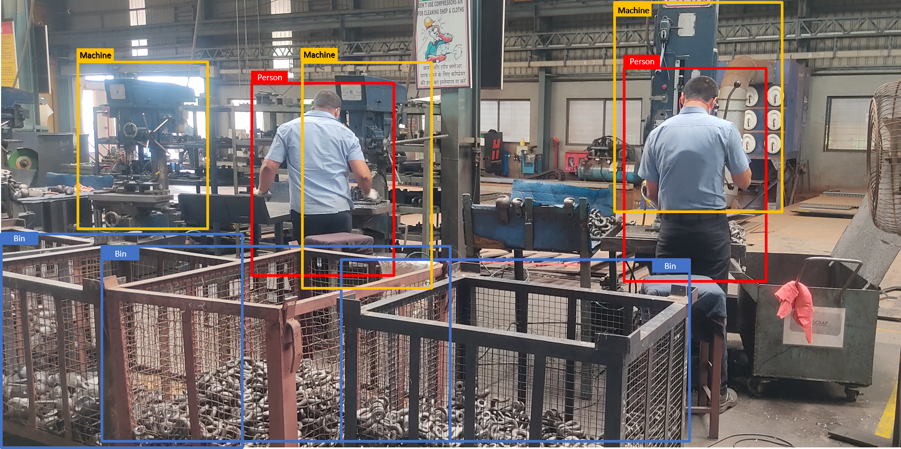
Data Sharing Agreement :
The 500 images are taken from client having specific size.

Slide 4
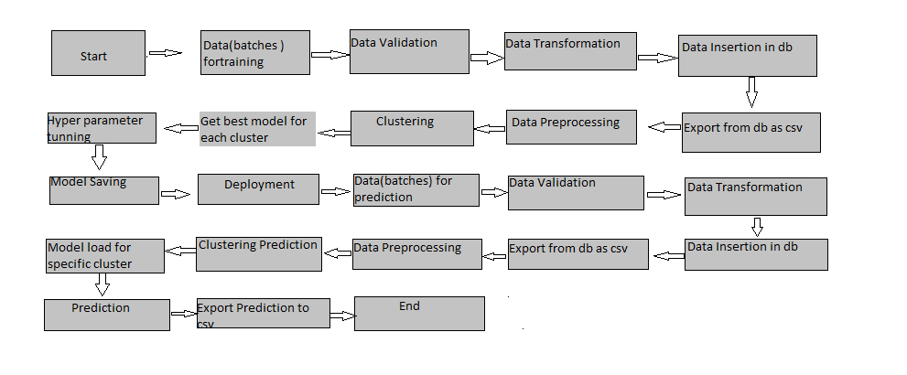
Architecture

Slide 5
Data Creation :
1] The data created my clicking the photos of the worker, machines, workplace and components or parts.
2] Multiple images will be created by replicating or scaling the images with different angles.

Slide 6
Data Insertion in Database:
Database will be arranged in required pattern and identical size.
Faulty or blurry images will be removed which are hard to train..

Slide 7
Model Training:
Data Export :
The accumulated images is used for model training
Data Preprocessing
Data augmentation strategies followed by image annotation.
Data augmentation consists of image rotation, contrast, and color adjustments, lighting variations, random erasing, etc.

Slide 8
Model Selection –
After the images are preprocessed , appropriate model will be selected.
Here , The model used is Convolution neural network (CNN)

Slide 9
Prediction:
Load an image
Resize it to a predefined size such as 224 x 224 pixels.
Scale the value of the pixels to the range [0, 255]
CNN network called ResNet-50 is used for pre-training
Run the pre-trained model.
Display the results.

Slide 10
Q & A:
Q1) What’s the source of data?
The data for training is provided taken by working team it self, with specified camera.
Q 2) What was the type of data?
The data was the combination of images.
Q 3) What’s the complete flow you followed in this Project?
Refer slide 5th for better Understanding
Q 4) After the File validation what you do with incompatible file or files which didn’t pass the validation?
Images which are blurry or not fit for training purpose are moved to archive folder as those images will be of no use.

Slide 11
Q 5) How logs are managed?
We are using different logs as per the steps that we follow in validation and
modeling like File validation log , Data Insertion ,Model Training log , prediction log
etc.
Q 6) What techniques were you using for data pre-processing?
Data augmentation strategies followed by image annotation.
Data augmentation consists of image rotation, contrast, and color adjustments, lighting variations, random erasing, etc.

Slide 12
Q 7) How training was done or what models were used?
Convolutional Neural Network is used to train the model for specific images of worker, workplace, components and machine.
Each type of images are trained in CNN ResNet-50 .
The scaling was performed over images to get multiple types of images
Types of layer like convolution and max pooling are adjusted .
Classification technique is used to determine the images and its motion.
Q 8) How Prediction was done?
From the test sample images , the samples where fed to model to recognize whether model identify motion or images correctly or not.

Slide 13
Q 9) What are the different stages of deployment?
When the model is ready we deploy it in Fire environment .Where SIT and UAT is performed over it.
Once We get Sign off from Fire we deploy in Earth and UAT is performed over it.
After getting the sign off from Earth we deploy in production

